Slide 1
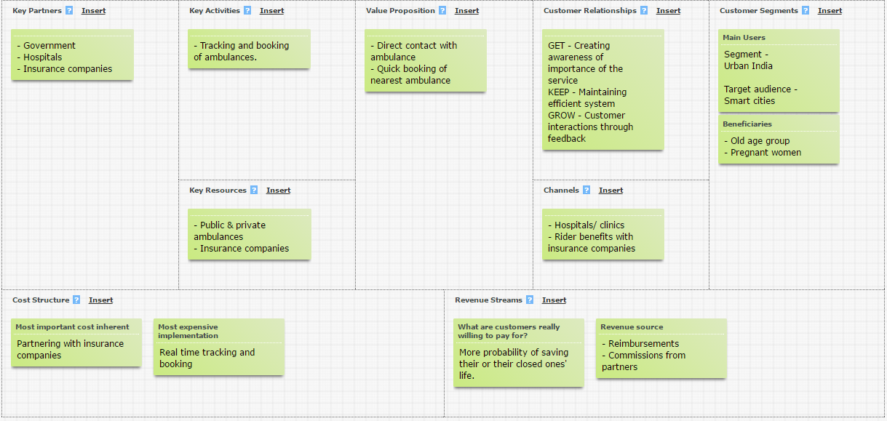
AmbiSure Business Model

